Slide 1
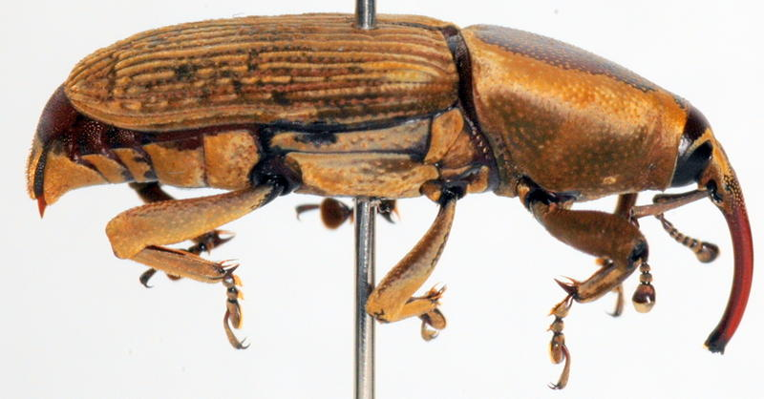
Evaluation of a Scratchpad Template as an Online
Database for the University of Guam Insect Collection
Aubrey Moore
Extension Entomologist
University of Guam

Slide 2
Part 1
Introduction

Slide 3
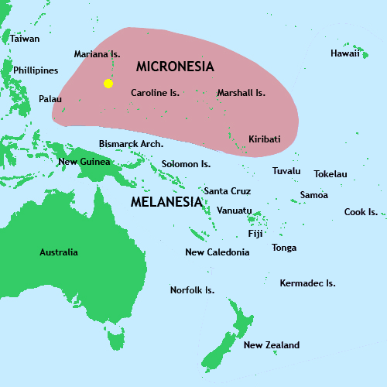
Where is Guam?

Slide 4
Challenges
Limited taxonomic expertise: only 3 PhD-level entomologists currently active in Micronesia
High endemism (~45%); many undescribed species
Very high introduction rate for alien insects

Slide 5
Resources
Limited Literature
  Hawaii Sugar Planters' Association survey of 1936 published by Bishop Museum in Insects of Guam (2 volumes)
  Bishop Museum surveys of 1950s and 60s published in Insects of Micronesia
Entomological Collections
  University of Guam
  Northern Marianas College, Saipan
  Palau National Museum

Slide 6
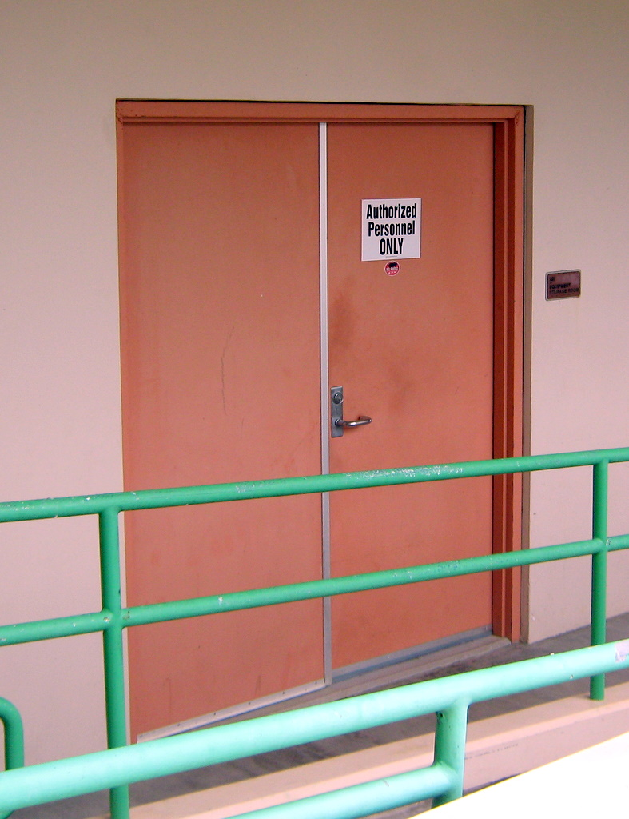
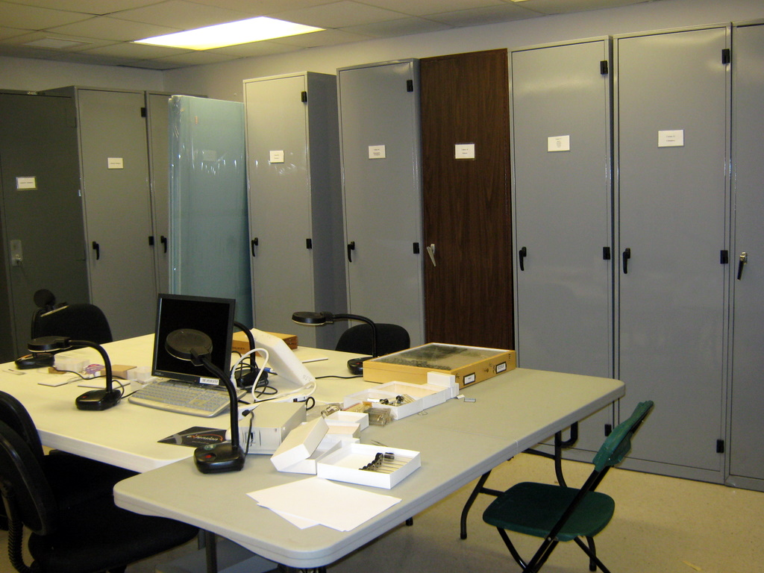
University of Guam Insect Collection

Slide 7
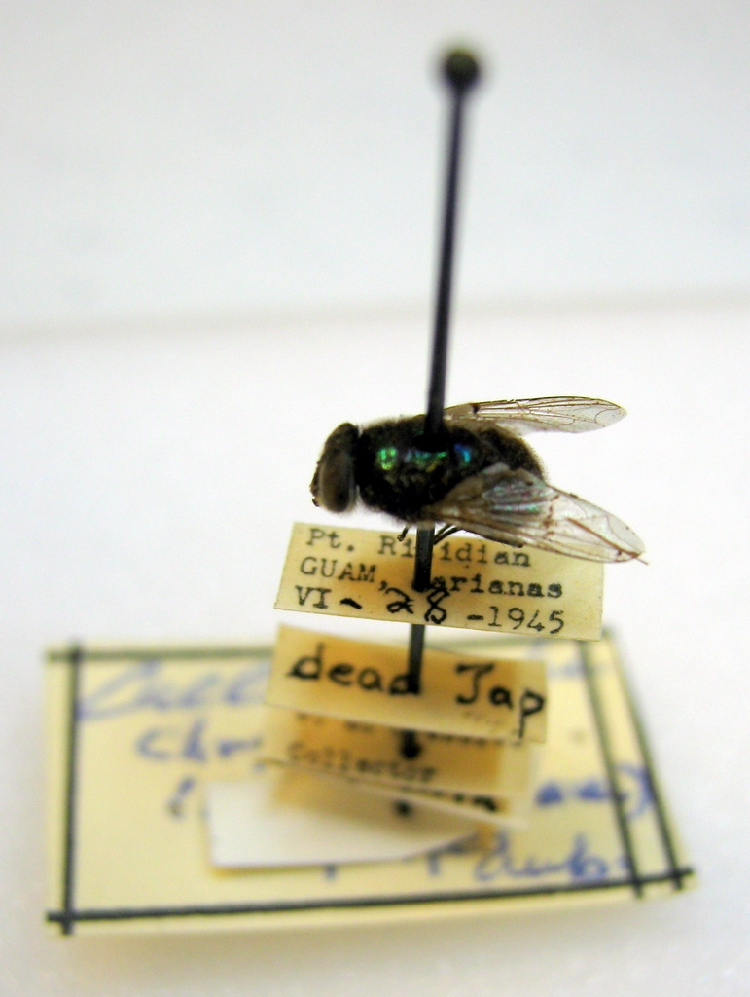
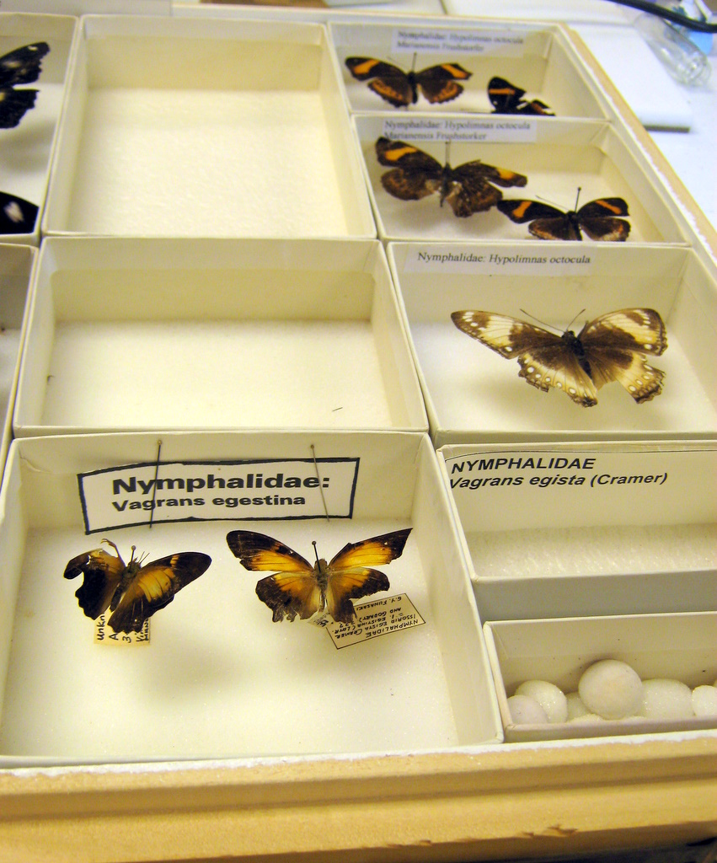
University of Guam Insect Collection

Slide 8
University of Guam Insect Collection
Curators
Ross Miller, University of Guam
Aubrey Moore, University of Guam
Board of Directors
Richard Zack, Washington State University
Robert Foottit, Agriculture Canada
Robert Sites, University of Missouri

Slide 9
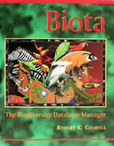
Digitization
Initial attempts at specimen level databasing failed.
All data lost due to hardware failures / defective back-up procedures

Slide 10

Digitization
Biodiversity Information Management System provided free by CSIRO, Australia
Development and support discontinued in 2005, however, BioLink has recently been reborn as an open source project
Written in Visual Basic 6/C++ and sits on top a MicroSoft SQL Server database
Typically run in client / server mode on a LAN or Internet

Slide 11
Digitization
Current Status
30,000 pinned specimens have been given a unique identifier and are recorded in our BioLink database

Slide 12
Desirable Features for an Online Collection Database
Free and open source
Reliable data security / backup
Flexible data security (user permissions)
Web browser used for data entry and information delivery
Specimen records compliant with Darwin Core
Storage for images, bibliographic data, informal notes, etc.
Data shared via GBIF

Slide 13


LifeDesks and Scratchpads
LifeDesks is part of the Encyclopedia of Life Project.
ScratchPads is a project managed by the Natural History Museum, London.
Both are Drupal templates hosted for free.
My evaluation sites are at:
http://micronesianinsects.lifedesks.org/
http://guaminsects.myspecies.info/

Slide 14
Part 2
Evaluation of a Scratchpad Template
as an Online Database for the
University of Guam Insect Collection

Slide 15
Insert PDF pages 14-17 from ScratchPadIntroTrainingOpt.pdf

Slide 16
Available Panels for Taxon Pages
Internal Data
Specimens
Images
Bibliographic refs
Blogs
External Data
References from Biodiversity Heritage Library, Google Scholar
Images from MorphBank, Flickr, Yahoo
GBIF Maps
More

Slide 17
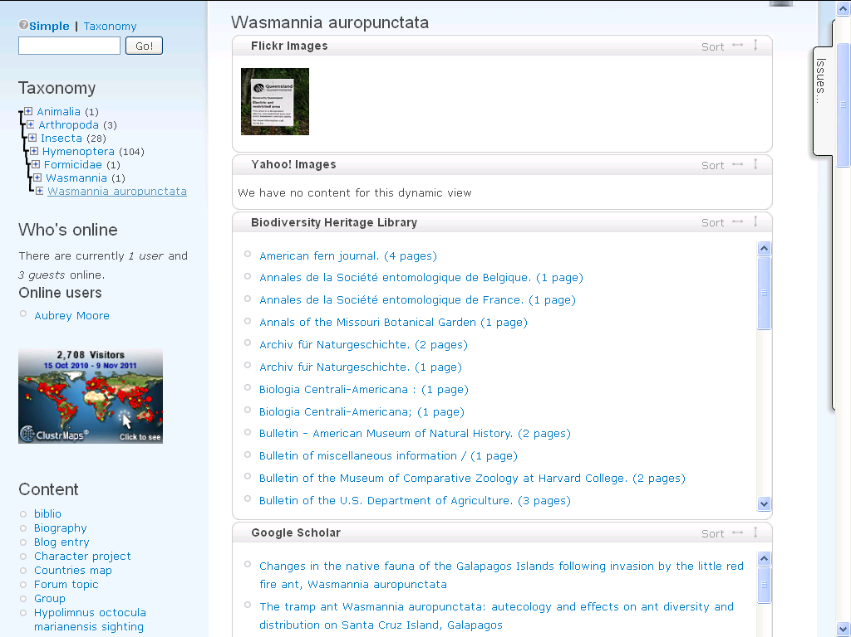

Slide 18
Likes & Dislikes
The Scratchpad template was not specifically designed as a collections database management system (DBMS)
Missing features: label printer, loans forms, etc.
Useful features not commonly found in collections DBMS:
  Blogs and forums (for incidental observations, special projects)
  Group pages with restricted access (bed bug reports, rare butterfly sightings)

Slide 19
Likes
Free hosting, backups, development
No installation: all interaction via web browser
Open source will allow me the option of "rolling my own" site if I choose to
Display of images at variable resolutions is good
Darwin Core data standards used for specimens and locations
Automatic discovery of associated data on the web via "Taxon Pages"

Slide 20
Dislikes
Batch import of data is extremely slow
Having problems merging imported data with existing data when importing taxonomic hierarchies
No direct access to underlying MySQL database for ad hoc queries using SQL
  Note: the Drupal Views Module can be used to do almost anything with the data, if you know how to use it

Slide 21
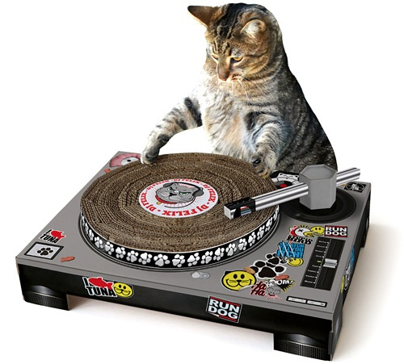
Dislikes
Scrachpads: the name is lame

Slide 22
Acknowledgments
Many thanks to the Natural History Museum and the Scratchpad Developers:
Simon Rycroft
Vince Smith
Irina Brake

Slide 23
Links to More Info
Scratchpads: a data-publishing framework to build, share and manage information on the diversity of life. BMC BioInformatics 2009 10(Suppl. 14). PDF
Streamlining taxonomic publication: a working example with Scratchpads and ZooKeys. ZooKeys 2010 (50) 17-28. PDF
Scratchpads Sand Box

